Slide 2


Slide 5


Slide 6
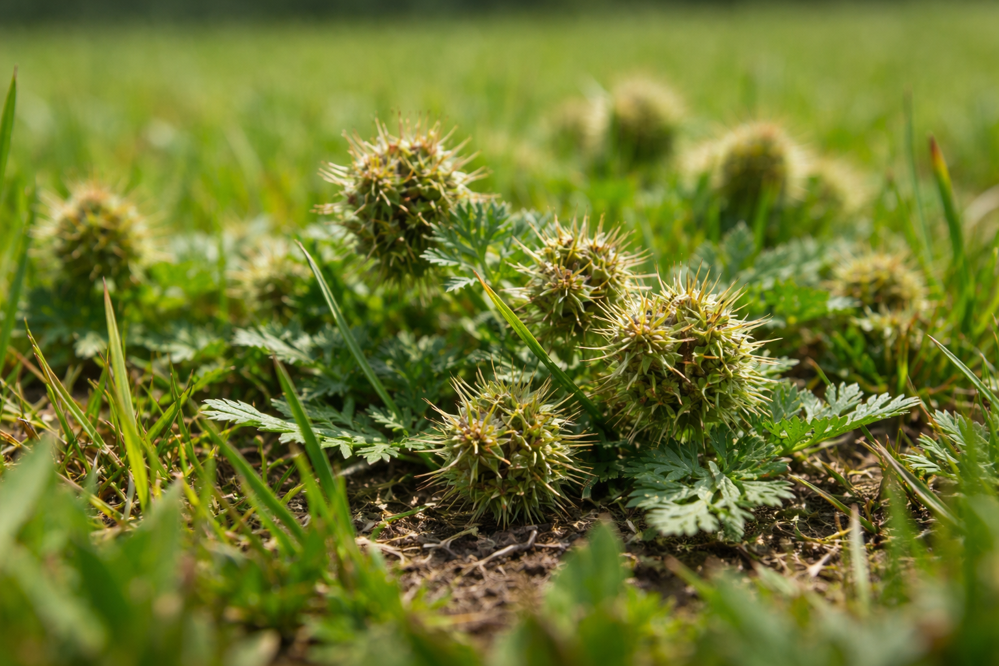

Slide 7
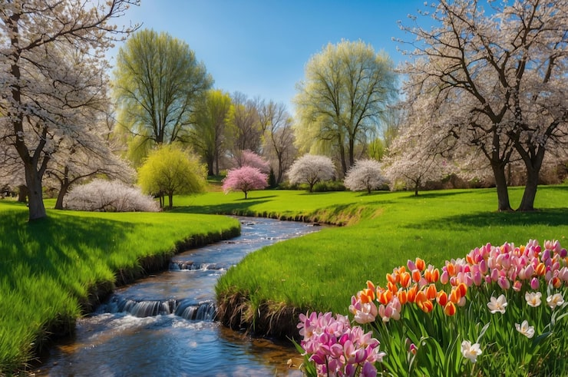

Slide 8


Slide 9
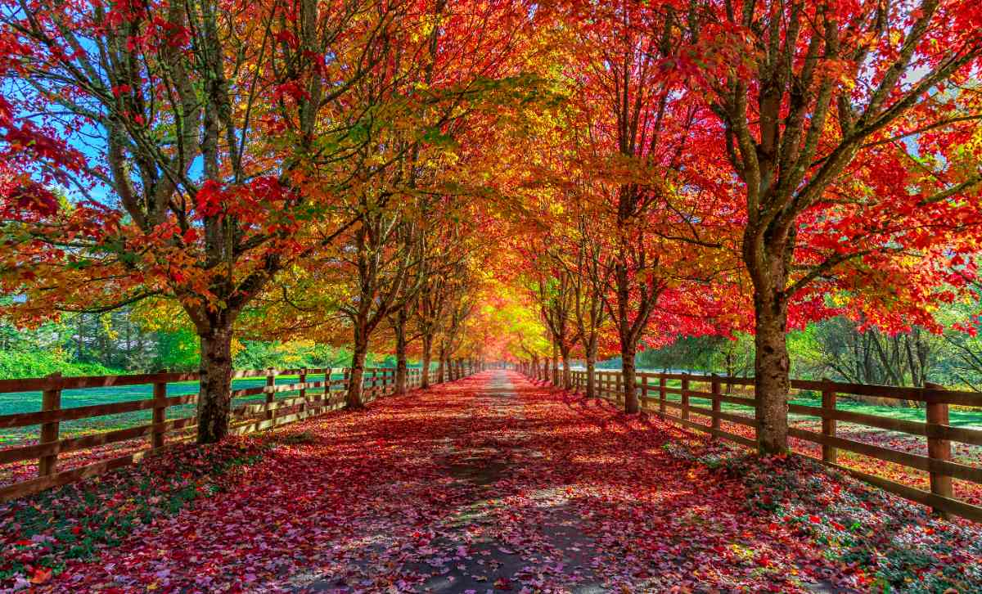

Slide 10

Chlorophyll

Slide 11
Are You Growing
in Christ?
2 Peter 3:18

Slide 12
Correcting some misconceptions about spiritual growth …
Spiritual growth doesn’t lead to salvation; it’s the outworking of salvation.

Slide 13
Salvation
Sanctification
Glorification

Slide 14
Correcting some misconceptions about spiritual growth …
Spiritual growth isn’t about getting saved; it’s the outworking of salvation.
Our growth in grace doesn’t cause God to love us more.
Spiritual growth happens over time, but it’s not automatic.

Slide 15
2 Corinthians 3:18
“But we all, with open face beholding as in a glass the glory of the Lord, are changed into the same image from glory to glory, even as by the Spirit of the Lord.”

Slide 16
Correcting some misconceptions about spiritual growth …
Spiritual growth is much more than Bible knowledge.
Spiritual growth is not measured by religious activity.
Spiritual growth is not marked by material prosperity.

Slide 17
In order to grow spiritually, you must …
Purposefully remove hindrances to growth.
Actively foster conditions that lead to growth.
Keep your focus on Jesus, our Savior and our Lord.

Slide 18
Hebrews 12 :1- 2
“Wherefore seeing we also are compassed about with so great a cloud of witnesses, let us lay aside every weight, and the sin which doth so easily beset us, and let us run with patience the race that is set before us, Looking unto Jesus the author and finisher of our faith; who for the joy that was set before him endured the cross, despising the shame, and is set down at the right hand of the throne of God.”

Slide 19
In order to grow spiritually, you must …
Purposefully remove hindrances to growth.
Actively foster conditions that lead to growth.
Keep your focus on following Jesus.
Recognize how desperately you need God’s grace to grow.

Slide 20
2 Peter 3:18
“But grow in grace, and in the knowledge of our Lord and Saviour Jesus Christ. To him be glory both now and for ever. Amen.”

